Slide 1
Nessus Demo - 2
Lets take a look at Nessus Demo
https://www.tenable.com/products/nessus/nessus-professional/evaluate
Download free 7 day trial
Get activation key from website

Slide 2
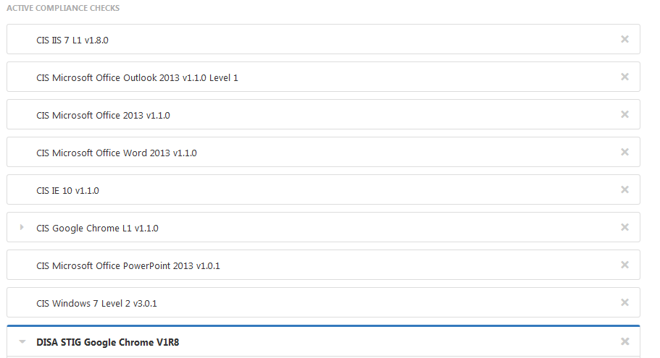
Nessus Demo - 2
ADVANCED SCAN / COMPLIANCE

Slide 3
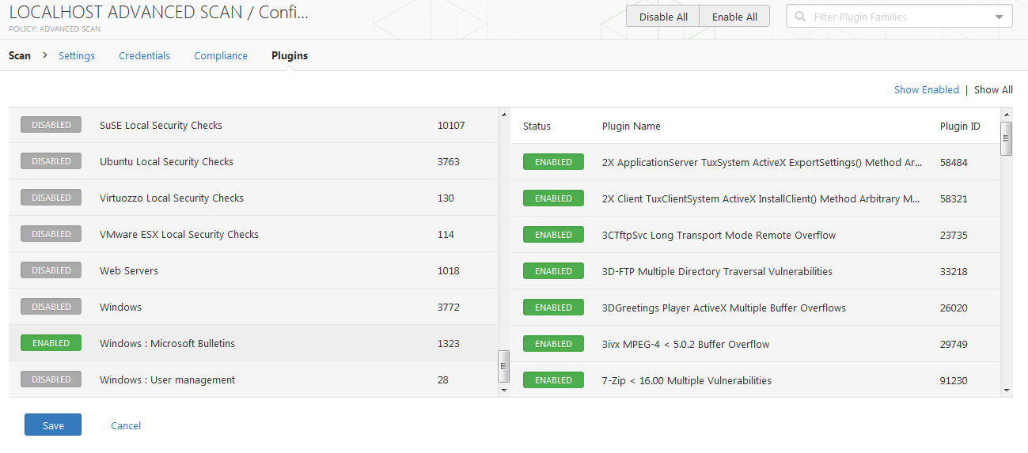
Nessus Demo - 2
ADVANCED SCAN / PLUG-INS

Slide 4
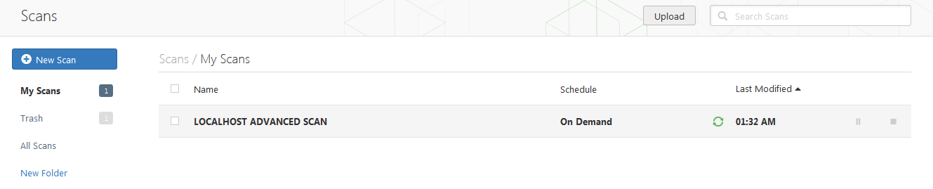
Nessus Demo - 2
SCAN…IN PROGRESS

Slide 5
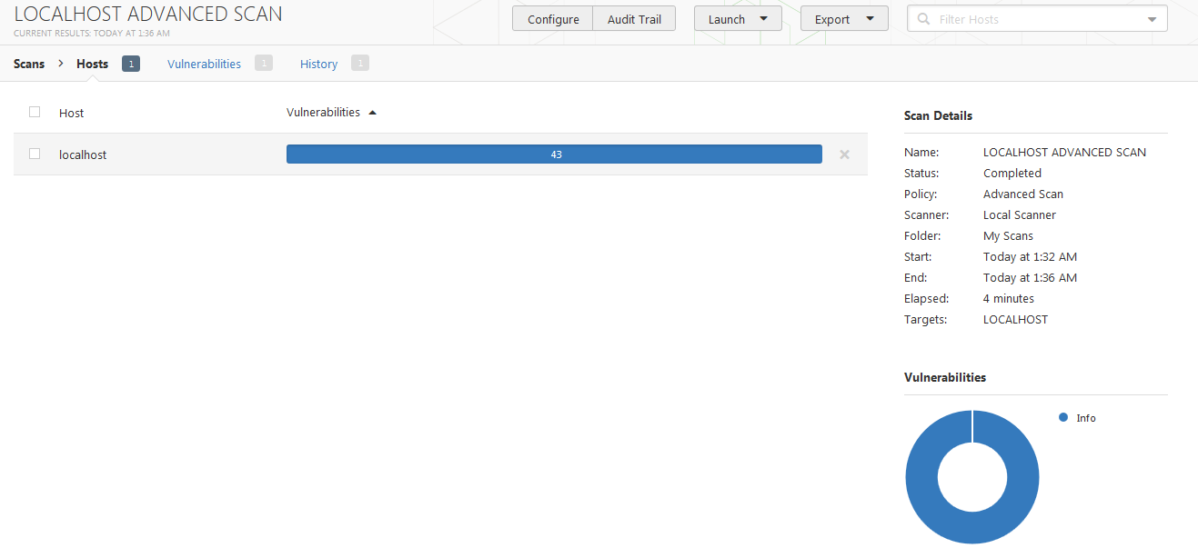
Nessus Demo - 2
SCAN REPORT [43 INFO]

Slide 6
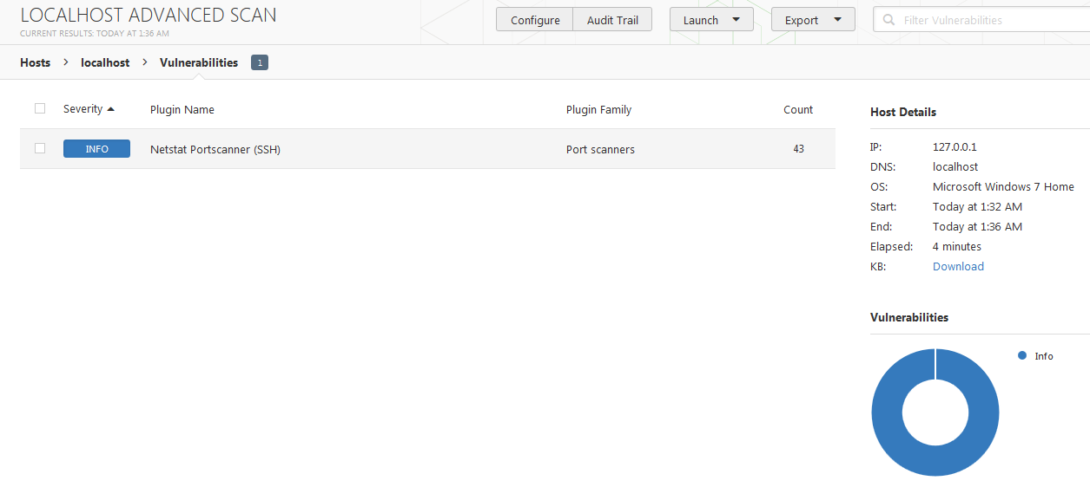
Nessus Demo - 2
SCAN REPORT [DETAILS]

Slide 7
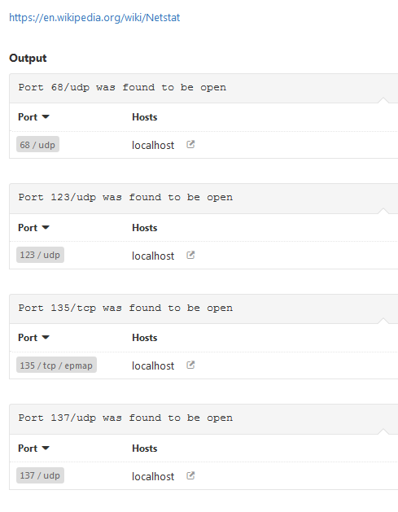
Nessus Demo - 2
SCAN REPORT [DETAILS…]

Slide 8
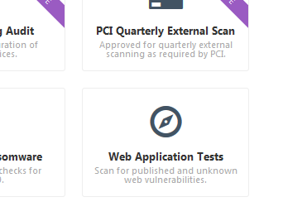
Nessus Demo - 2
WEB APPLICATION TEST

Slide 9
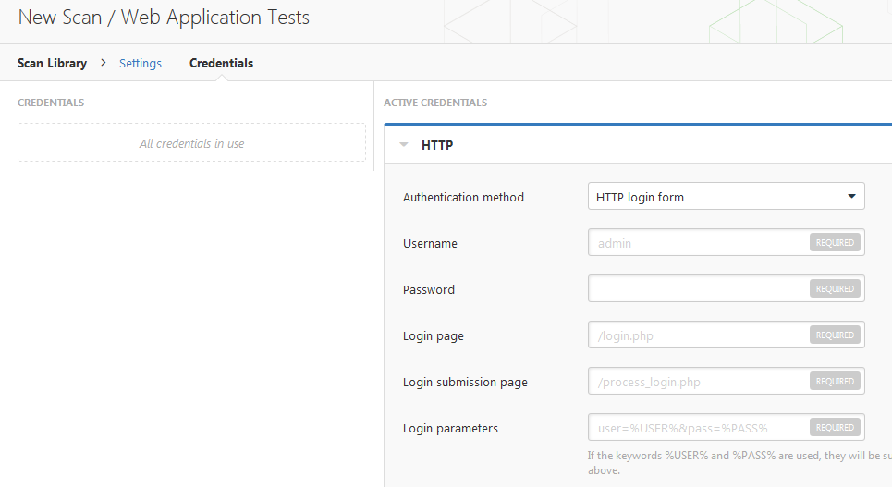
Nessus Demo - 2
WEB APPLICATION TEST - CREDENTIALS

Slide 10
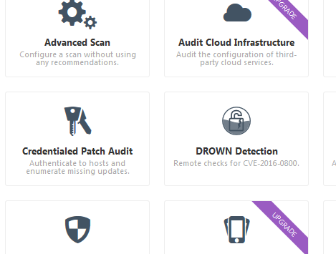
Nessus Demo - 2
CREDENTIALED PATCH AUDIT

Slide 11
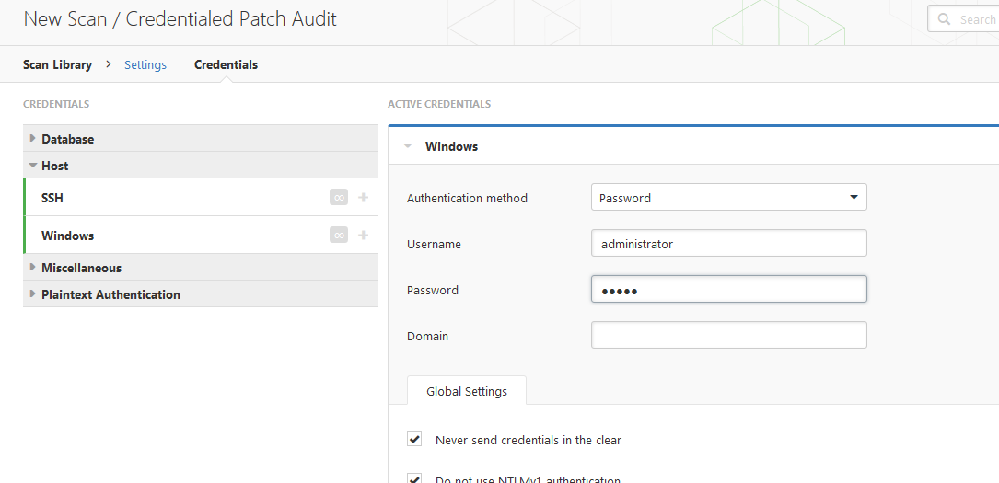
Nessus Demo - 2
CREDENTIALED PATCH AUDIT

Slide 12
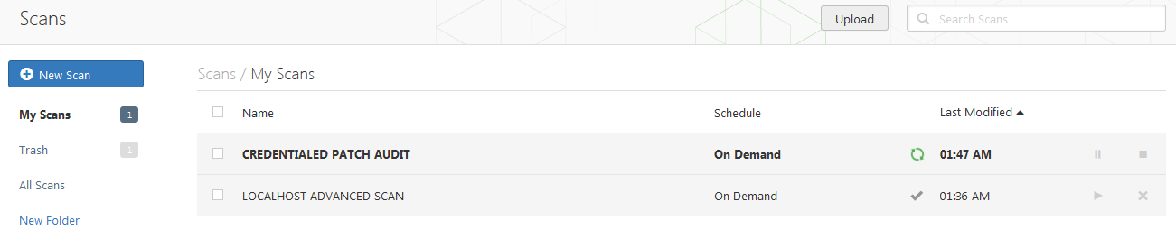
Nessus Demo - 2
SCANS DASHBOARD

Slide 13

Nessus Demo - 2
CREDENTIALED AUDIT SCAN RESULTS [61 INFO]

Slide 14
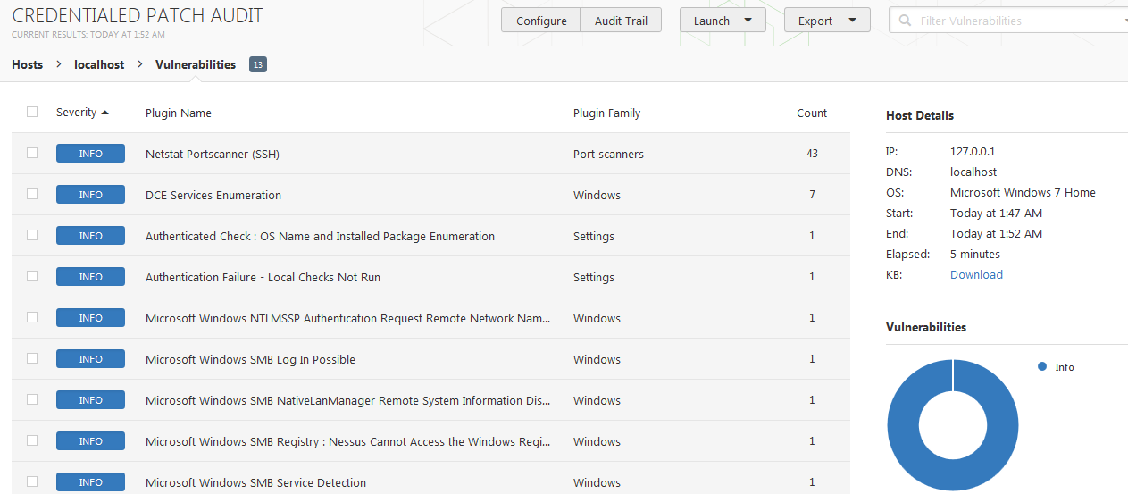
Nessus Demo - 2
CREDENTIALED AUDIT SCAN RESULTS [61 INFO]

Slide 15
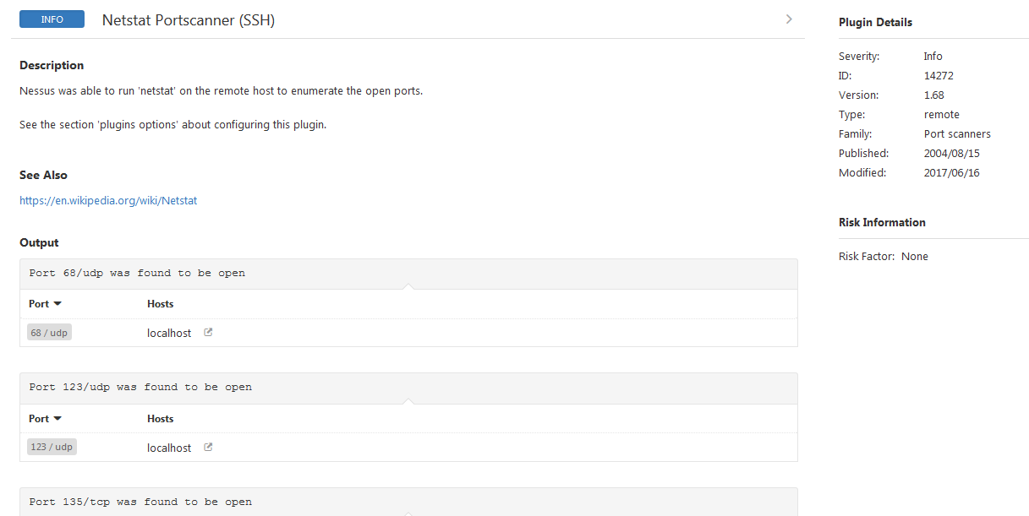
Nessus Demo - 2
CREDENTIALED AUDIT SCAN RESULTS [DETAILS]

Slide 16
Nessus Demo - 2
Lets take a look at Nessus Demo
https://www.tenable.com/products/nessus/nessus-professional/evaluate
Download free 7 day trial
Get activation key from website

